Slide 1
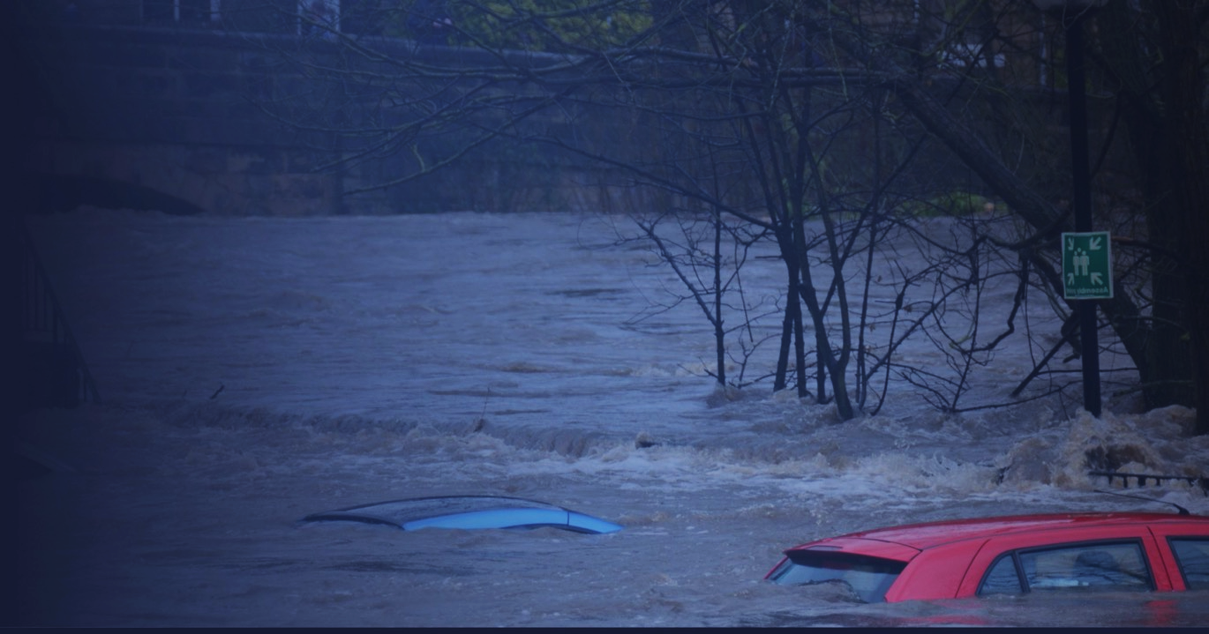

Slide 2
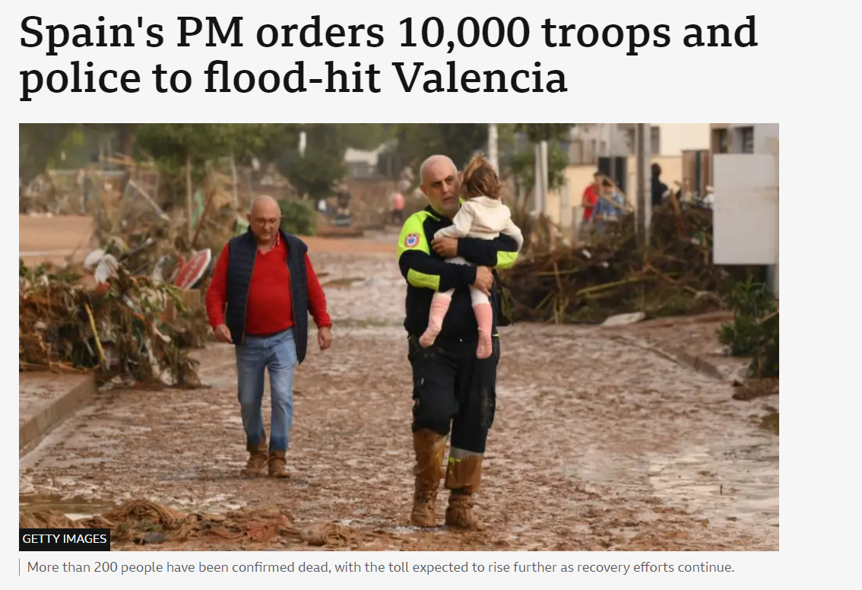
What’s been happening in the recently…

Slide 3
Floods are UK’s most prevalent natural disaster by far, impacting everyone
Floods are UK’s most prevalent natural disaster, impacting everyone
33%
of commercial properties are at risk today, increases expected in short run
£132k
Average cost per incident
5 times
Expected growth in flood costs in UK until 2050

Slide 4
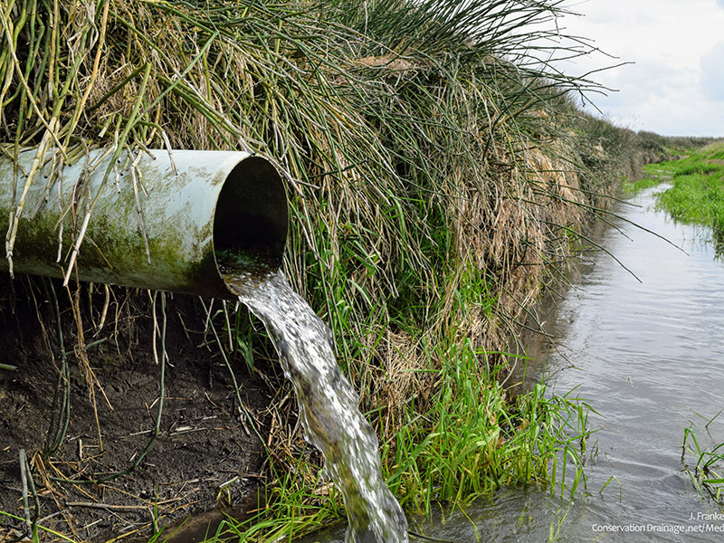
Why are floods getting worse?

Slide 5
Climate Change

Slide 6
Climate Change
Urbanisation

Slide 7
Climate Change
Urbanisation
Drainage

Slide 8
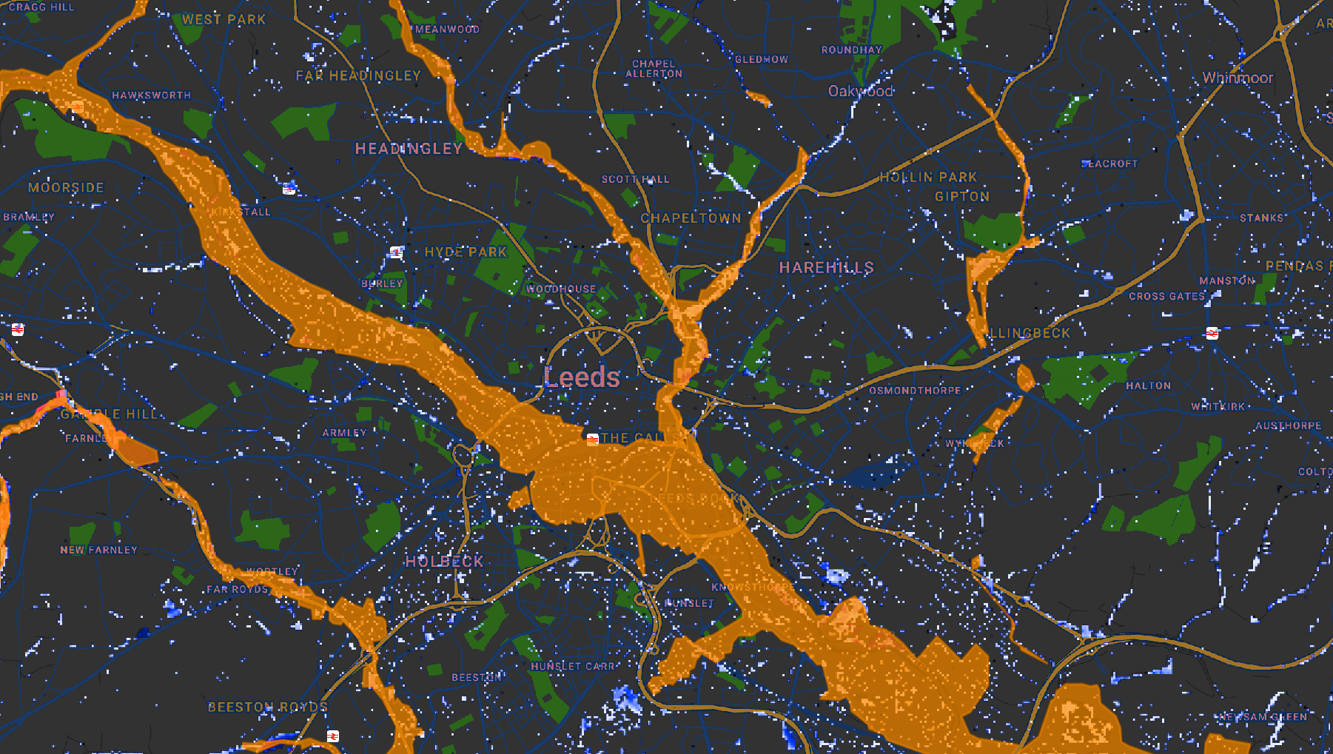
There is a large gap in existing tools to support flood response​
56% of floods not covered
(i.e surface water floods)
No property detail, only broad geographical area
Lack of local condition data
(i.e. drainage systems, small river/streams data)
EA warnings
Flooding

Slide 9
Our combined forecasting solution delivers risk management, alerting and proactive monitoring allow for 50% of flood cost mitigation
Combined solution possible
Forecasting alerts
IoT Sensors
Property-level, surface flood alerts up to 48 hours before flood
24/7 live-monitoring of key water ways at >99.9% accuracy

Slide 10
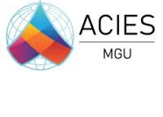
Our solutions are currently live with over 200 organisations in the UK, consistently delivering ROI
Utilities and infrastructure
Property management
Government
Insurers
Partners

Slide 11
What have we achieved ?

Slide 12
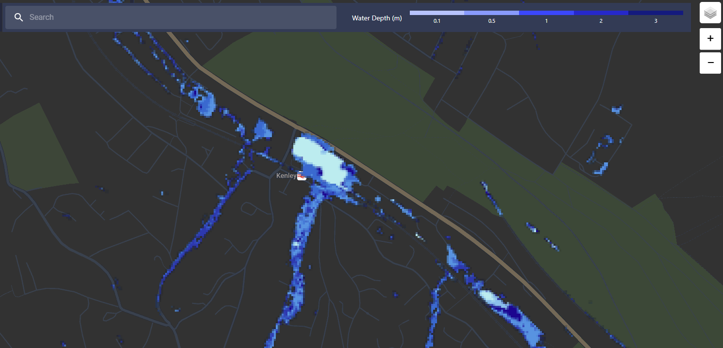
Residents and the council were promptly notified, and a contractor was called to the scene to clear the balancing pond
Preventing any flood to households during the day

Slide 13
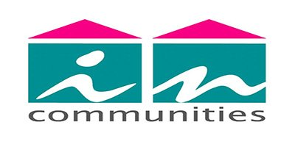
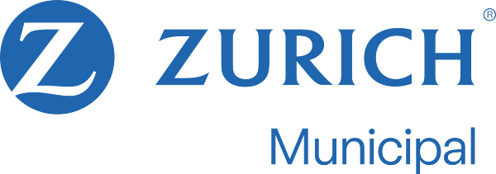
How Incommunities Housing Association used Previsico to mitigate their flood risk
Benefits
Problem
Incommunties is a social and affordable housing association based in Yorkshire, managing more than 22,600 homes.
Incommunities previously experienced flood impacts, related to heavy rainfall events, which resulted in challenges to ensure its tenants were protected and supported.
Positive sentiment amongst Incommunities tenants, thanking them for responding to their needs
Solution
Able to identify areas of concern, including need to take better approach to mitigating risk for properties
After assessing the options, the housing association adopted Previsico’s solution to help mitigate flood risks.
The team at Incommunities were able to improve and adapt their mitigation solution by working with Previsico through their insurer, Zurich Municipal.
Incommunities is now able to help to accurately characterise flood impacts and risk areas.
>10x ROI
Notes:
We also work with Lead Local Flood Authorities in a variety of ways – instrumenting ordinary watercourses and highways assets, including gulleys (surface water drianage)
In the context of our work with Devon, we have instrumented a subset of their highways gulleys providing them visibility of flood risk and levels of silt within chambers, supporting both proactive and reactive maintenance activities, including gulley clearance – which is resource intensive and so the means to support understanding of when clearance should be undertaken, is beneficial.

Slide 14
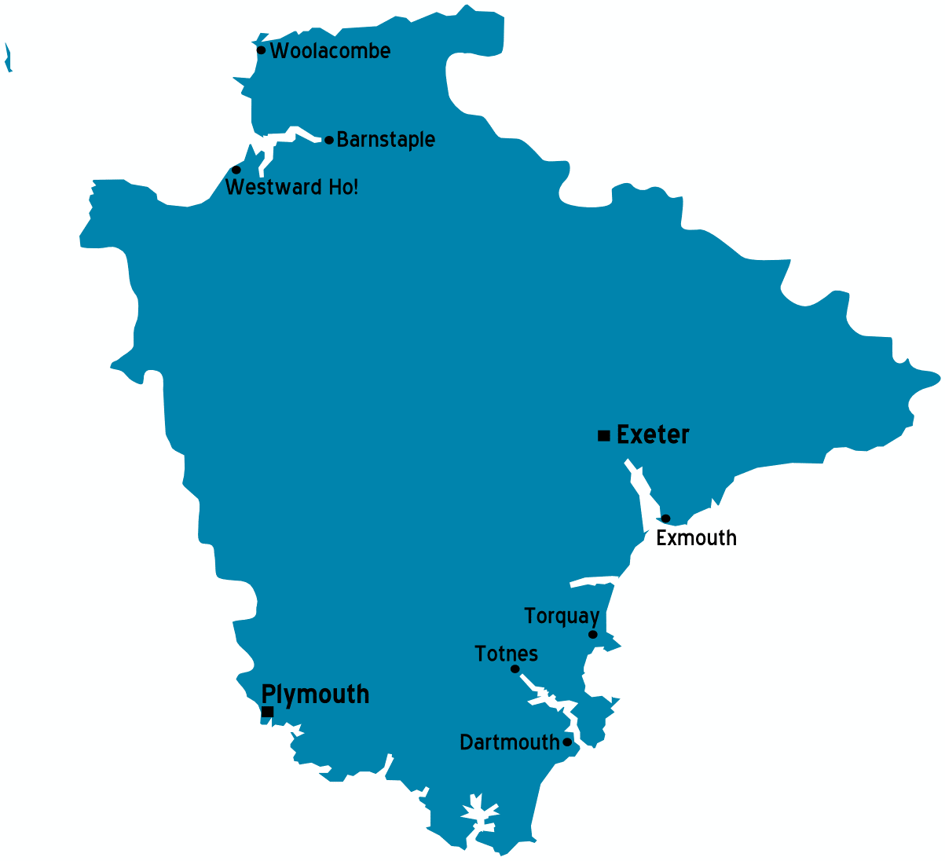
Benefits
Proactive flood alerting for high-risk assets during events driving effective mitigation.
Optimisation of maintenance schedules, preliminary results show number of gully cleaning visits HALVED
Informing effective capital works planning and delivery for future investment

Slide 15
Thank you!
Want to spread the word about Previsico?
Refer a business to us to receive a £50 amazon voucher
CONNECT WITH US Lewis.seale@previsico.com +44 07 538 702 940 previsico.com

